Slide 1
“I Swear!”
Matthew 5:33-37
Dr. Rick Griffith, Crossroads International Church
www.BibleStudyDownloads.org

Slide 2
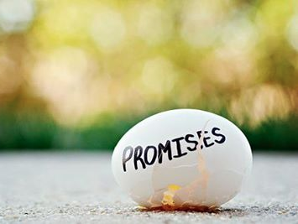
We easily make promises.

Slide 3
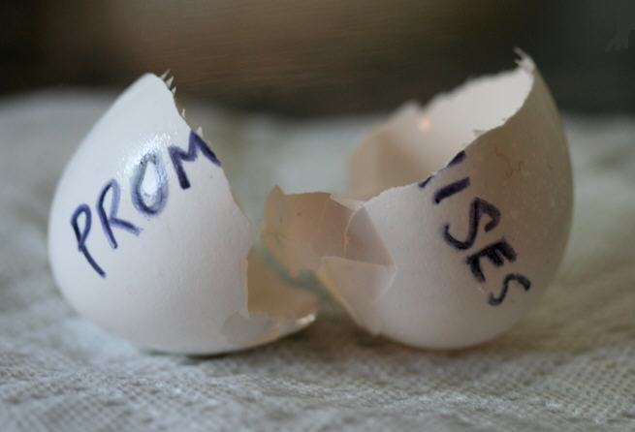
We easily break promises.

Slide 4
Political Promises

Slide 5
Marriage Promises

Slide 6
Can’t deliver…

Slide 7
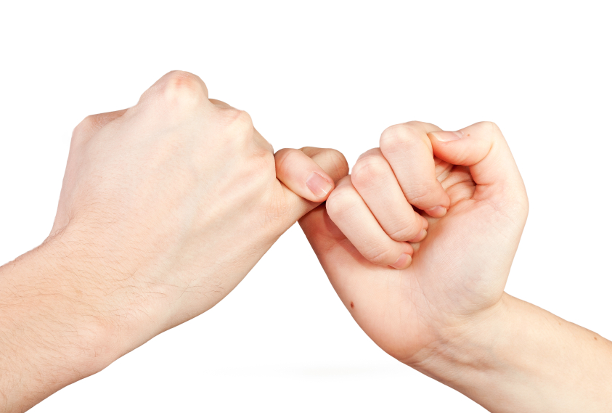
Are you a person of your word?

Slide 8
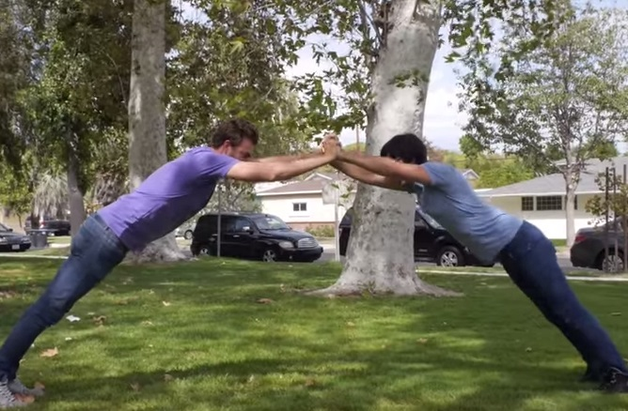
Do your friends trust you?

Slide 9
Marriage Promises

Slide 10
Do you strive to make sure you do what you say?

Slide 11
Are you punctual?

Slide 12
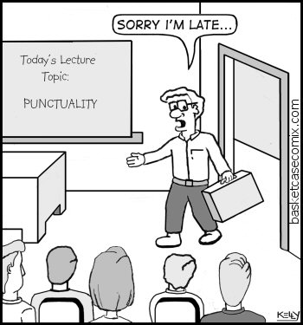
Are you punctual?

Slide 13
Are you punctual?

Slide 14
Punctuality:
Showing high regard for other people and their time.

Slide 15
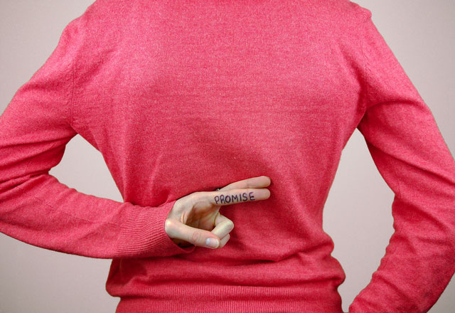
Are you reliable?

Slide 16
How should you treat your vows?

Slide 17
Back to Basics (Matt. 5:21-48)
"You have heard that it was said…"
6 Issues:
"But I tell you…"
Murder
Adultery
Divorce
Vows
Revenge
Enemies
God's True Intent
Pharisee Teaching
External purity won't enter the kingdom (20)
Notes:
Here we see how "Jesus rejected the traditions of the Pharisees (vv. 21-48) … Six times Jesus said, "You have heard that it was said. ... But I tell you" (5:21-22, 27-28, 31-32, 33-34, 38-39, 43-44). These words make it clear that Jesus was presenting (a) what the Pharisees and teachers of the Law were saying to the people and, by contrast, (b) what God's true intent of the Law was. This spelled out His statement (v. 20) that Pharisaic righteousness is not enough to gain entrance into the coming kingdom" (Barbieri, BKC, 2:30).

Slide 18
How should you treat your vows?
— 2 ways —

Slide 19
I. Keep your vows (5:33).

Slide 20
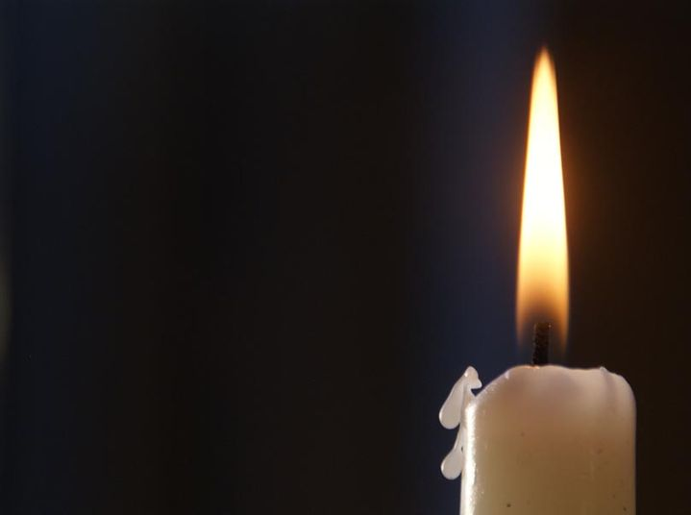
"You have also heard that our ancestors were told, 'You must not break your vows; you must carry out the vows you make to the Lord'" (5:33 NLT).

Slide 21
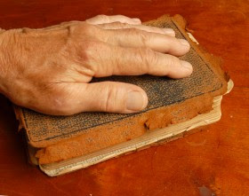
«When you make a vow to the Lord your God, be prompt in fulfilling whatever you promised him. For the Lord your God demands that you promptly fulfill all your vows, or you will be guilty of sin" (Deut. 23:21 NLT).

Slide 22
"Scripture" (5: NLT).

Slide 23
"Scripture" (5: NLT).

Slide 24
PROMISES

Slide 25
Title

Slide 26
"Scripture" (5: NLT).

Slide 27
"Scripture" (5: NLT).

Slide 28
"Scripture" (5: NLT).

Slide 29
Black on White

Slide 30
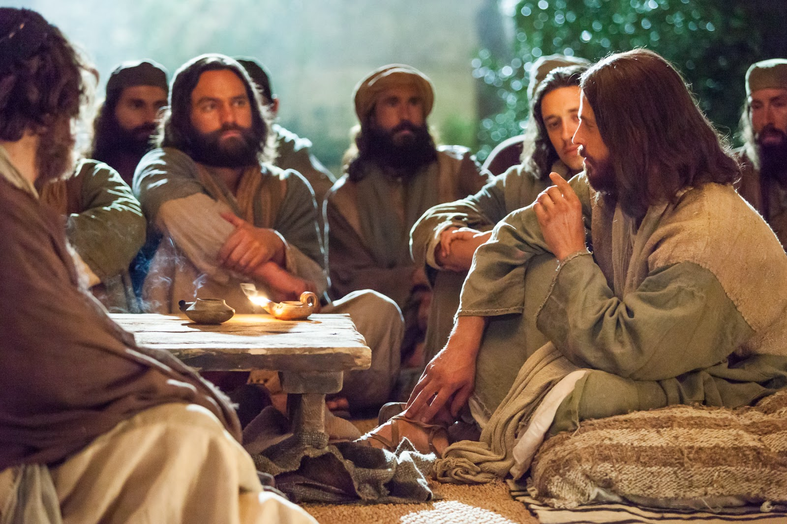
I. Main Point

Slide 31
"But I say, do not make any vows! Do not say, 'By heaven!' because heaven is God's throne. ³⁵And do not say, 'By the earth!' because the earth is his footstool. And do not say, 'By Jerusalem!' for Jerusalem is the city of the great King. ³⁶Do not even say, 'By my head!' for you can't turn one hair white or black" (5:34-36 NLT).

Slide 32
"Just say a simple, 'Yes, I will,' or 'No, I won't.' Anything beyond this is from the evil one" (5:37 NLT).

Slide 33
"But most of all, my brothers and sisters, never take an oath, by heaven or earth or anything else. Just say a simple yes or no, so that you will not sin and be condemned" (James 5:12 NLT).

Slide 34
"Scripture" (5: NLT).

Slide 35
"Scripture" (5: NLT).

Slide 36
Worship

Slide 37
Worship

Slide 38
"Scripture" (5: NLT).

Slide 39
"Scripture" (5: NLT).

Slide 40
"Scripture" (5: NLT).

Slide 41
"Scripture" (5: NLT).

Slide 42
Black on White

Slide 43
I. Main Point

Slide 44
"Scripture" (5: NLT).

Slide 45
"Scripture" (5: NLT).

Slide 46
"Scripture" (5: NLT).

Slide 47
"Scripture" (5: NLT).

Slide 48
"Scripture" (5: NLT).

Slide 49
"Scripture" (5: NLT).

Slide 50
Black on White

Slide 51
I. Main Point

Slide 52
"Scripture" (5: NLT).

Slide 53
"Scripture" (5: NLT).

Slide 54
"Scripture" (5: NLT).

Slide 55
"Scripture" (5: NLT).

Slide 56
Black on White

Slide 57
NT Sermons link at biblestudydownloads.org
Get this presentation and script for free!

Slide 58
Black

